Slide 1
Parallel Programming With Spark

Slide 2
Resilient Distributed Datasets
A Fault-Tolerant Abstraction for In-Memory Cluster Computing

Slide 3
Motivation
MapReduce greatly simplified “big data” analysis on large, unreliable clusters
But as soon as it got popular, users wanted more:
More complex, multi-stage applications (e.g. iterative machine learning & graph processing)
More interactive ad-hoc queries
Response: specialized frameworks for some of these apps (e.g. Pregel for graph processing)
Notes:
We all know that MapReduce and related models had huge adoption for data mining
But as soon as people started putting data into them, they wanted to do more

Slide 4
Motivation
Complex apps and interactive queries both need one thing that MapReduce lacks:
Efficient primitives for data sharing
In MapReduce, the only way to share data across jobs is stable storage ➔ slow!

Slide 5
Examples
HDFS read
HDFS write
HDFS read
HDFS write
iter. 1
iter. 2
. . .
Input
HDFS read
query 1
result 1
query 2
result 2
query 3
result 3
Input
. . .
Slow due to replication and disk I/O, but necessary for fault tolerance
Notes:
Emphasize that the overhead of replication and disk IO from HDFS comes from FT

Slide 6
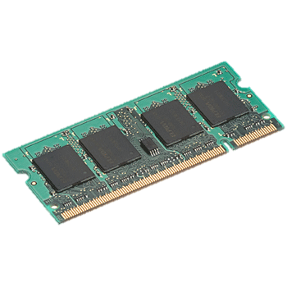
Goal: In-Memory Data Sharing
iter. 1
iter. 2
. . .
Input
query 1
one-time processing
query 2
query 3
Input
. . .
10-100× faster than network/disk, but how to get FT?

Slide 7
Challenge
How to design a distributed memory abstraction that is both fault-tolerant and efficient?

Slide 8
Challenge
Existing storage abstractions have interfaces based on fine-grained updates to mutable state
RAMCloud, databases, distributed mem, Piccolo
Requires replicating data or logs across nodes for fault tolerance
Costly for data-intensive apps
10-100x slower than memory write
Notes:
Say it’s expensive for data-intensive apps in particular
Data-intensive vs transactional -> show spectrum with update granularity and write throughput

Slide 9
Solution: Resilient Distributed Datasets (RDDs)
Restricted form of distributed shared memory
Immutable, partitioned collections of records
Can only be built through coarse-grained deterministic transformations (map, filter, join, …)
Efficient fault recovery using lineage
Log one operation to apply to many elements
Recompute lost partitions on failure
No cost if nothing fails
Notes:
Define RDDs more precisely here!

Slide 10
RDD Recovery
iter. 1
iter. 2
. . .
Input
query 1
one-time processing
query 2
query 3
Input
. . .

Slide 11
Generality of RDDs
Despite their restrictions, RDDs can express surprisingly many parallel algorithms
These naturally apply the same operation to many items
Unify many current programming models
Data flow models: MapReduce, Dryad, SQL, …
Specialized models for iterative apps: BSP (Pregel), iterative MapReduce (Haloop), bulk incremental, …
Support new apps that these models don’t
Notes:
Similarity to GFS/HDFS: large blocks, append only.

Slide 12
Tradeoff Space
Fine
K-V stores,
databases,
RAMCloud
Best for
transactional
workloads
Granularity
of Updates
Best for batch
workloads
HDFS
RDDs
Coarse
Low
High
Write Throughput

Slide 13
Spark Programming Interface
Usable interactively from Scala interpreter
Provides:
Resilient distributed datasets (RDDs)
Operations on RDDs: transformations (build new RDDs), actions (compute and output results)
Control of each RDD’s partitioning (layout across nodes) and persistence (storage in RAM, on disk, etc)
Notes:
Mention that Scala is a JVM language

Slide 14

Example: Log Mining
Load error messages from a log into memory, then interactively search for various patterns
Base RDD
Msgs. 1
lines = spark.textFile(“hdfs://...”)
errors = lines.filter(_.startsWith(“ERROR”))
messages = errors.map(_.split(‘\t’)(2))
Messages.cache
Transformed RDD
Worker
results
tasks
Block 1
Master
Action
messages.filter(_.contains(“foo”)).count
messages.filter(_.contains(“bar”)).count
Msgs. 2
Worker
Msgs. 3
Result: full-text search of Wikipedia in <1 sec (vs 20 sec for on-disk data)
Worker
Block 2
Result: scaled to 1 TB data in 5-7 sec (vs 170 sec for on-disk data)
Block 3
Notes:
Key idea: add “variables” to the “functions” in functional programming

Slide 15
Fault Recovery
RDDs track the graph of transformations that built them (their lineage) to rebuild lost data
E.g.:
messages = textFile(...).filter(_.contains(“error”))
.map(_.split(‘\t’)(2))
HadoopRDD
FilteredRDD
MappedRDD
HadoopRDD
path = hdfs://…
FilteredRDD
func = _.contains(...)
MappedRDD
func = _.split(…)

Slide 16
Fault Recovery Results
Failure happens
Notes:
These are for K-means

Slide 17
Example: PageRank
1. Start each page with a rank of 1
2. On each iteration, update each page’s rank to
Σ_{i∈neighbors} rank_{i} / |neighbors_{i}|
links = // RDD of (url, neighbors) pairs
ranks = // RDD of (url, rank) pairs
for (i <- 1 to ITERATIONS) {
ranks = links.join(ranks).flatMap {
(url, (links, rank)) =>
links.map(dest => (dest, rank/links.size))
}.reduceByKey(_ + _)
}

Slide 18
Optimizing Placement
Links
(url, neighbors)
Ranks₀
(url, rank)
links & ranks repeatedly joined
Can co-partition them (e.g. hash both on URL) to avoid shuffles
Can also use app knowledge, e.g., hash on DNS name
links = links.partitionBy( new URLPartitioner())
join
Contribs₀
reduce
Ranks₁
join
Contribs₂
reduce
Ranks₂
. . .

Slide 19
PageRank Performance

Slide 20
Implementation
Runs on YARN/Mesos to share clusters w/ Hadoop
Can read from any Hadoop input source (HDFS, S3, …)
Spark
Hadoop
MPI
…
YARN / Mesos
Node
Node
Node
Node
No changes to Scala language or compiler
Reflection + bytecode analysis to correctly ship code
www.spark-project.org

Slide 21
Programming Models Implemented on Spark
RDDs can express many existing parallel models
MapReduce, DryadLINQ
Pregel graph processing [200 LOC]
Iterative MapReduce [200 LOC]
SQL: Hive on Spark (Shark)
Enables apps to efficiently intermix these models
All are based on coarse-grained operations
Notes:
Emphasize Shark

Slide 22
Conclusion
RDDs offer a simple and efficient programming model for a broad range of applications
Leverage the coarse-grained nature of many parallel algorithms for low-overhead recovery
Try it out at www.spark-project.org

Slide 23
Behavior with Insufficient RAM

Slide 24
Spark Operations
Transformations (define a new RDD) | map filter groupByKey reduceByKey sortByKey | flatMap union Join cogroup mapPartition
Actions (return a result to driver program) | collect reduce count saveAsTextFile lookupKey

Slide 25
Task Scheduler
A:
B:
DAGs
Pipelines functions within a stage
Locality & data reuse aware
Partitioning-aware to avoid shuffles
G:
Stage 1
groupBy
C:
D:
F:
map
E:
join
Stage 2
union
Stage 3
= cached data partition
Notes:
NOT a modified version of Hadoop

Slide 26
How to Run It
Local multicore: just a library in your program
EC2: scripts for launching a Spark cluster
Private cluster:
YARN
Standalone Mode
Mesos

Slide 27
Languages
APIs in Java, Scala and Python
Interactive shells in Scala and Python

Slide 28
Outline
Introduction to Spark
Tour of Spark operations
Job execution
Standalone programs
Deployment options
Notes:
By the end of this, here’s what you’ll be able to do
Feel free to ask questions in the middle -> on Piazza?

Slide 29
Operations
Transformations (e.g. map, filter, groupBy, join)
Lazy operations to build RDDs from other RDDs
Actions (e.g. count, collect, save)
Return a result or write it to storage
Notes:
You write a single program → similar to DryadLINQ
Distributed data sets with parallel operations on them are pretty standard; the new thing is that they can be reused across ops
Variables in the driver program can be used in parallel ops; accumulators useful for sending information back, cached vars are an optimization
Mention cached vars useful for some workloads that won’t be shown here
Mention it’s all designed to be easy to distribute in a fault-tolerant fashion

Slide 30
Spark in Java and Scala
Java API:
JavaRDD<String> lines = spark.textFile(…); errors = lines.filter( new Function<String, Boolean>() { public Boolean call(String s) { return s.contains(“ERROR”); } }); errors.count()
Scala API:
val lines = spark.textFile(…) errors = lines.filter(s => s.contains(“ERROR”)) // can also write filter(_.contains(“ERROR”)) errors.count

Slide 31
Which Language Should I Use?
Standalone programs can be written in any, but console is only Python & Scala
Python developers: can stay with Python for both
Java developers: consider using Scala for console (to learn the API)
Performance: Java / Scala will be faster (statically typed), but Python can do well for numerical work with NumPy

Slide 32
Scala Cheat Sheet
Variables:
var x: Int = 7 var x = 7 // type inferred
val y = “hi” // read-only
Collections and closures:
val nums = Array(1, 2, 3)
nums.map((x: Int) => x + 2) // => Array(3, 4, 5)
nums.map(x => x + 2) // => same nums.map(_ + 2) // => same
nums.reduce((x, y) => x + y) // => 6 nums.reduce(_ + _) // => 6
Functions:
def square(x: Int): Int = x*x
def square(x: Int): Int = { x*x // last line returned }
Java interop:
import java.net.URL
new URL(“http://cnn.com”).openStream()
More details:
scala-lang.org

Slide 33
Outline
Introduction to Spark
Tour of Spark operations
Job execution
Standalone programs
Deployment options
Notes:
By the end of this, here’s what you’ll be able to do
Feel free to ask questions in the middle -> on Piazza?

Slide 34
Learning Spark
Easiest way: Spark interpreter (spark-shell or pyspark)
Special Scala and Python consoles for cluster use
Runs in local mode on 1 thread by default, but can control with MASTER environment var:
MASTER=local ./spark-shell # local, 1 thread MASTER=local[2] ./spark-shell # local, 2 threads MASTER=spark://host:port ./spark-shell # Spark standalone cluster

Slide 35
First Stop: SparkContext
Main entry point to Spark functionality
Created for you in Spark shells as variable sc
In standalone programs, you’d make your own (see later for details)

Slide 36
Creating RDDs
# Turn a local collection into an RDD
sc.parallelize([1, 2, 3])
# Load text file from local FS, HDFS, or S3
sc.textFile(“file.txt”)
sc.textFile(“directory/*.txt”)
sc.textFile(“hdfs://namenode:9000/path/file”)
# Reading from a SequenceFile
sc.sequenceFile(path,keyClass,valClass)
# Use any existing Hadoop InputFormat
sc.hadoopFile[keyClass, valClass, inputFmt](path)

Slide 37
Basic Transformations
nums = sc.parallelize([1, 2, 3])
# Pass each element through a function
squares = nums.map(lambda x: x*x) # => {1, 4, 9}
# Keep elements passing a predicate
even = squares.filter(lambda x: x % 2 == 0) # => {4}
# Map each element to zero or more others
nums.flatMap(lambda x: range(0, x)) # => {0, 0, 1, 0, 1, 2}
Range object (sequence of numbers 0, 1, …, x-1)
Notes:
All lazy

Slide 38
Basic Actions
nums = sc.parallelize([1, 2, 3])
# Retrieve RDD contents as a local collection nums.collect() # => [1, 2, 3]
# Return first K elements nums.take(2) # => [1, 2]
# Count number of elements nums.count() # => 3
# Merge elements with an associative function nums.reduce(lambda x, y: x + y) # => 6
# Write elements to a text file nums.saveAsTextFile(“hdfs://file.txt”)
Notes:
Launch computations

Slide 39
Working with Key-Value Pairs
Spark’s “distributed reduce” transformations act on RDDs of key-value pairs
Python: pair = (a, b)
pair[0] # => a
pair[1] # => b
Scala: val pair = (a, b)
pair._1 // => a
pair._2 // => b
Java: Tuple2 pair = new Tuple2(a, b); // class scala.Tuple2
pair._1 // => a
pair._2 // => b

Slide 40
Some Key-Value Operations
pets = sc.parallelize([(“cat”, 1), (“dog”, 1), (“cat”, 2)])
pets.reduceByKey(lambda x, y: x + y) # => {(cat, 3), (dog, 1)}
pets.groupByKey() # => {(cat, Seq(1, 2)), (dog, Seq(1)}
pets.sortByKey() # => {(cat, 1), (cat, 2), (dog, 1)}
reduceByKey also automatically implements combiners on the map side
Notes:
val pets=sc.parallelize(List(("cat",1),("dog",1),("cat",2)))

Slide 41
Example: Word Count
lines = sc.textFile(“hamlet.txt”)
counts = lines.flatMap(lambda line: line.split(“ ”)) \ .map(lambda word: (word, 1)) \ .reduceByKey(lambda x, y: x + y)
“to” “be” “or”
(to, 1) (be, 1) (or, 1)
(be, 2) (not, 1)
“to be or”
“not” “to” “be”
(not, 1) (to, 1) (be, 1)
(or, 1)
(to, 2)
“not to be”

Slide 42
Multiple Datasets
visits = sc.parallelize([(“index.html”, “1.2.3.4”), (“about.html”, “3.4.5.6”), (“index.html”, “1.3.3.1”)])
pageNames = sc.parallelize([(“index.html”, “Home”), (“about.html”, “About”)])
visits.join(pageNames) # (“index.html”, (“1.2.3.4”, “Home”)) # (“index.html”, (“1.3.3.1”, “Home”)) # (“about.html”, (“3.4.5.6”, “About”))
visits.cogroup(pageNames) # (“index.html”, (Seq(“1.2.3.4”, “1.3.3.1”), Seq(“Home”))) # (“about.html”, (Seq(“3.4.5.6”), Seq(“About”)))

Slide 43
Controlling the Level of Parallelism
All the pair RDD operations take an optional second parameter for number of tasks
words.reduceByKey(lambda x, y: x + y, 5)
words.groupByKey(5)
visits.join(pageViews, 5)

Slide 44
Using Local Variables
External variables you use in a closure will automatically be shipped to the cluster:
query = raw_input(“Enter a query:”)
pages.filter(lambda x: x.startswith(query)).count()
Some caveats:
Each task gets a new copy (updates aren’t sent back)
Variable must be Serializable (Java/Scala) or Pickle-able (Python)
Don’t use fields of an outer object (ships all of it!)

Slide 45
Closure Mishap Example
class MyCoolRddApp { val param = 3.14 val log = new Log(...) ... def work(rdd: RDD[Int]) { rdd.map(x => x + param) .reduce(...) } }
How to get around it:
class MyCoolRddApp { ... def work(rdd: RDD[Int]) { val param_ = param rdd.map(x => x + param_) .reduce(...) } }
NotSerializableException: MyCoolRddApp (or Log)
References only local variable instead of this.param

Slide 46
More Details
Spark supports lots of other operations!
Full programming guide: spark-project.org/documentation

Slide 47
Outline
Introduction to Spark
Tour of Spark operations
Job execution
Standalone programs
Deployment options
Notes:
By the end of this, here’s what you’ll be able to do
Feel free to ask questions in the middle -> on Piazza?

Slide 48
Software Components
Spark runs as a library in your program (one instance per app)
Runs tasks locally or on a cluster
Standalone deploy cluster, Mesos or YARN
Accesses storage via Hadoop InputFormat API
Can use HBase, HDFS, S3, …
Your application
SparkContext
Cluster manager
Local threads
Worker
Worker
Spark executor
Spark executor
HDFS or other storage

Slide 49
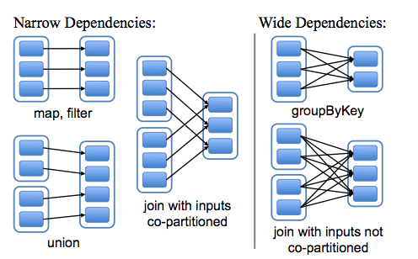
RDD Repersentations

Slide 50
Task Scheduler
Supports general task graphs
Pipelines functions where possible
Cache-aware data reuse & locality
Partitioning-aware to avoid shuffles
A:
B:
F:
Stage 1
groupBy
C:
D:
E:
join
Stage 2
map
filter
Stage 3
= RDD
= cached partition
Notes:
NOT a modified version of Hadoop

Slide 51
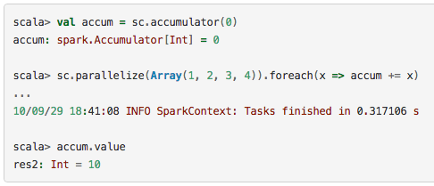
Accumulator Variables
Variables that are only “added” to through an associative operation in parallel

Slide 52
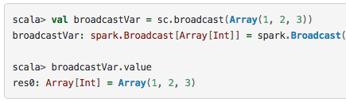
Broadcast Variables
Read-only variable cached on each machine instead of shipping it with every task

Slide 53
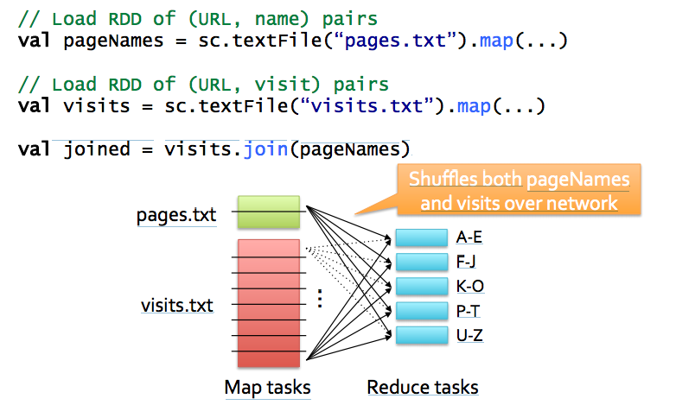
Example: Join

Slide 54
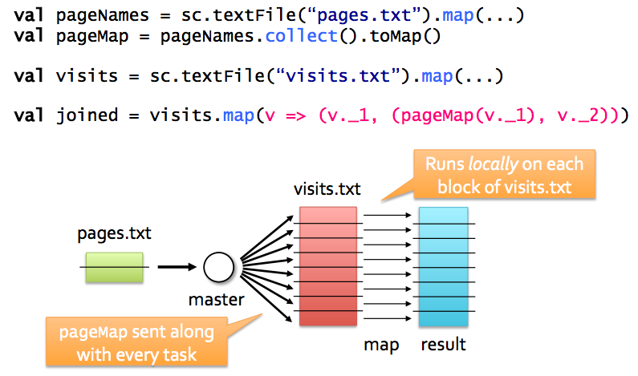
Alternative if One Table is Small

Slide 55
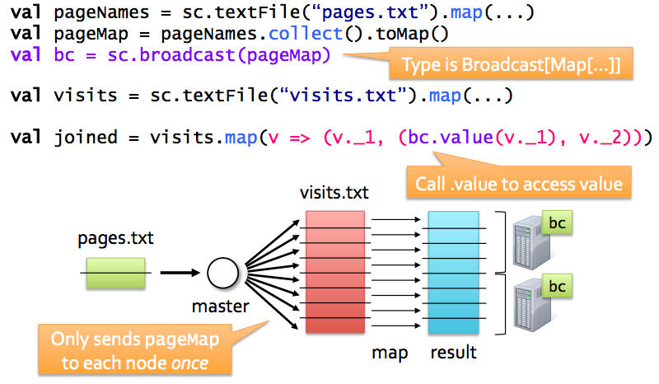
Better Version with Broadcast

Slide 56
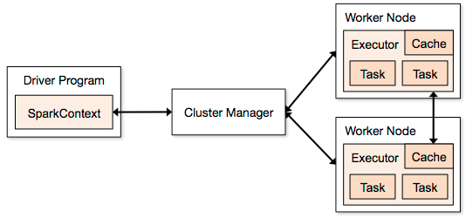
Spark Components
Spark Context
DAG Scheduler
Task Scheduler
Block Manager
Defines and tracks RDDS
Allocates resources across applications
Standalone
Mesos
Yarn
Runs computations
Stores data

Slide 57
Spark Config
Environment variables (conf/spark-env.sh)
Spark Properties
Set by passing a SparkConf object to SparkContext

Slide 58
Spark Tuning CPU <–> Network Bandwidth <-> Memory
Data Serialization
Java/Kryo Serialization
Memory Tuning
Tuning Data Structures
Avoid Strings, use primitive types instead of collections
Serialized RDD Storage
MEMORY_ONLY_SER
Level of Parallelism
Memory Usage of Reduce Tasks
Broadcasting Large Variables

Slide 59
Hadoop Compatibility
Spark can read/write to any storage system / format that has a plugin for Hadoop!
Examples: HDFS, S3, HBase, Cassandra, Avro, SequenceFile
Reuses Hadoop’s InputFormat and OutputFormat APIs
APIs like SparkContext.textFile support filesystems, while SparkContext.hadoopRDD allows passing any Hadoop JobConf to configure an input source

Slide 60
Outline
Introduction to Spark
Tour of Spark operations
Job execution
Standalone programs
Deployment options
Notes:
By the end of this, here’s what you’ll be able to do
Feel free to ask questions in the middle -> on Piazza?

Slide 61
Build Spark
Requires Java 6+, Scala 2.9.2
git clone git://github.com/mesos/spark cd spark sbt/sbt package
# Optional: publish to local Maven cache sbt/sbt publish-local

Slide 62
Add Spark to Your Project
Scala and Java: add a Maven dependency on
groupId: org.spark-project artifactId: spark-core_2.9.1 version: 0.7.0-SNAPSHOT
Python: run program with our pyspark script

Slide 63
Create a SparkContext
import spark.SparkContext
import spark.SparkContext._
val sc = new SparkContext(“masterUrl”, “name”, “sparkHome”, Seq(“app.jar”))
Scala
Cluster URL, or local / local[N]
App name
Spark install path on cluster
List of JARs with app code (to ship)
import spark.api.java.JavaSparkContext;
JavaSparkContext sc = new JavaSparkContext(
“masterUrl”, “name”, “sparkHome”, new String[] {“app.jar”}));
Java
from pyspark import SparkContext
sc = SparkContext(“masterUrl”, “name”, “sparkHome”, [“library.py”]))
Python
Notes:
Mention assembly JAR in Maven etc
Use the shell with your own JAR`

Slide 64
Complete App: Scala
import spark.SparkContext
import spark.SparkContext._
object WordCount { def main(args: Array[String]) {
val sc = new SparkContext(“local”, “WordCount”, args(0), Seq(args(1))) val lines = sc.textFile(args(2)) lines.flatMap(_.split(“ ”)) .map(word => (word, 1)) .reduceByKey(_ + _) .saveAsTextFile(args(3)) } }

Slide 65
Complete App: Python
import sys
from pyspark import SparkContext
if __name__ == "__main__":
sc = SparkContext( “local”, “WordCount”, sys.argv[0], None) lines = sc.textFile(sys.argv[1])
lines.flatMap(lambda s: s.split(“ ”)) \ .map(lambda word: (word, 1)) \ .reduceByKey(lambda x, y: x + y) \ .saveAsTextFile(sys.argv[2])

Slide 66
Example: PageRank

Slide 67
Why PageRank?
Good example of a more complex algorithm
Multiple stages of map & reduce
Benefits from Spark’s in-memory caching
Multiple iterations over the same data

Slide 68
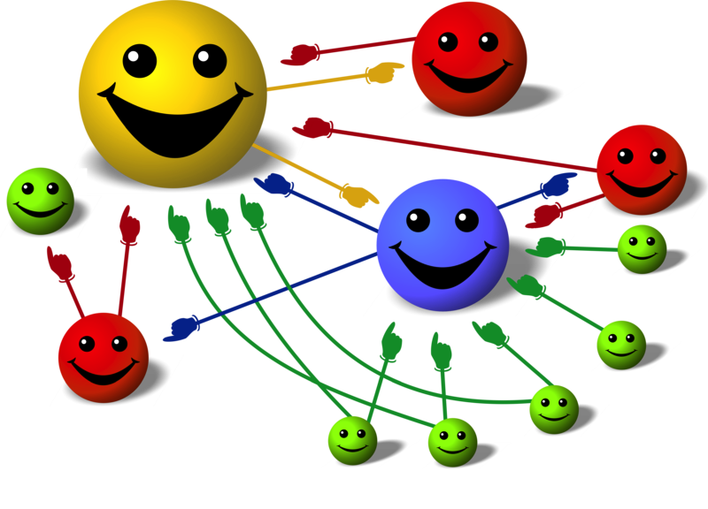
Basic Idea
Give pages ranks (scores) based on links to them
Links from many pages ➔ high rank
Link from a high-rank page ➔ high rank
Image: en.wikipedia.org/wiki/File:PageRank-hi-res-2.png

Slide 69
Algorithm
Start each page at a rank of 1
On each iteration, have page p contribute rank_{p} / |neighbors_{p}| to its neighbors
Set each page’s rank to 0.15 + 0.85 × contribs
1.0
1.0
1.0
1.0

Slide 70
Algorithm
Start each page at a rank of 1
On each iteration, have page p contribute rank_{p} / |neighbors_{p}| to its neighbors
Set each page’s rank to 0.15 + 0.85 × contribs
1.0
1
0.5
1
1.0
0.5
1.0
0.5
0.5
1.0

Slide 71
Algorithm
Start each page at a rank of 1
On each iteration, have page p contribute rank_{p} / |neighbors_{p}| to its neighbors
Set each page’s rank to 0.15 + 0.85 × contribs
1.85
0.58
1.0
0.58

Slide 72
Algorithm
Start each page at a rank of 1
On each iteration, have page p contribute rank_{p} / |neighbors_{p}| to its neighbors
Set each page’s rank to 0.15 + 0.85 × contribs
1.85
0.58
0.5
1.85
0.58
0.29
1.0
0.5
0.29
0.58

Slide 73
Algorithm
Start each page at a rank of 1
On each iteration, have page p contribute rank_{p} / |neighbors_{p}| to its neighbors
Set each page’s rank to 0.15 + 0.85 × contribs
1.31
0.39
. . .
1.72
0.58

Slide 74
Algorithm
Start each page at a rank of 1
On each iteration, have page p contribute rank_{p} / |neighbors_{p}| to its neighbors
Set each page’s rank to 0.15 + 0.85 × contribs
Final state:
1.44
0.46
1.37
0.73

Slide 75
Scala Implementation
val links = // RDD of (url, neighbors) pairs
var ranks = // RDD of (url, rank) pairs
for (i <- 1 to ITERATIONS) {
val contribs = links.join(ranks).flatMap {
case (url, (links, rank)) =>
links.map(dest => (dest, rank/links.size))
} ranks = contribs.reduceByKey(_ + _) .mapValues(0.15 + 0.85 * _)
} ranks.saveAsTextFile(...)

Slide 76
Python Implementation
links = # RDD of (url, neighbors) pairs
ranks = # RDD of (url, rank) pairs
for i in range(NUM_ITERATIONS):
def compute_contribs(pair): [url, [links, rank]] = pair # split key-value pair
return [(dest, rank/len(links)) for dest in links]
contribs = links.join(ranks).flatMap(compute_contribs)
ranks = contribs.reduceByKey(lambda x, y: x + y) \ .mapValues(lambda x: 0.15 + 0.85 * x) ranks.saveAsTextFile(...)

Slide 77
PageRank Performance
Notes:
54 GB Wikipedia dataset

Slide 78
Thank You!!

